Slide 1
Module 23: Understanding the Physical User Interface
Siebel Core Developer and Technology School
Notes:
Time: Lecture: 20 – 25 minutes; labs: 20 – 25 minutes
Intent: To define Web templates and how they are used in the Siebel application. Students learn how user interface object definitions reference Web templates.
Flow: Define Web templates, examine templates in tools, list the UI objects that reference Web templates, discuss the modes for list applet Web templates.
Key Terms:
Web Template file
Web Template object definition
View Web Template
List Applet Web Template
Form Applet Web Template
Web Page Web Template
Please note: Faculty-specific notes are italicized.

Slide 2

Module Objectives
After completing this module you will be able to:
  Describe the Physical User Interface
  Describe the role of Siebel Web Template files
  List the types of templates
  List the object definitions that relate UI objects to the template files
Why you need to know:
  Understanding templates aids in configuring the Siebel user interface
Notes:
Each objective and “why you need to know” should be stated aloud.

Slide 3
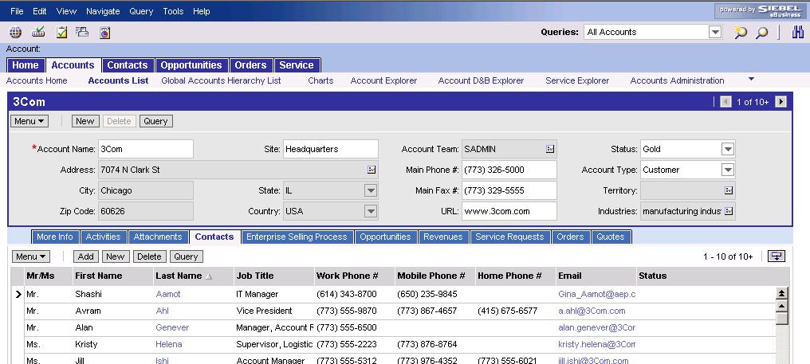
Web Templates
Specify the layout of the Siebel application
Are used by the Object Manager to build the Siebel UI at runtime
Object Manager
.SRF
.CFG
.SWT
Siebel Web Templates
Notes:
Students learned that the Object Manager uses Web templates in the architecture section. This module explains Web templates in more detail.

Slide 4
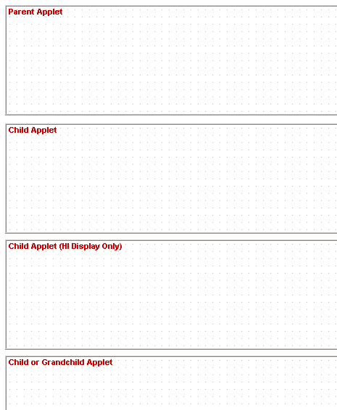
Siebel User Interface
Uses Web Templates to lay out logical user interface definitions
  Web Pages
  Views
  Applets
Placeholders
for Applets
Notes:
This is an example of a view Web template. The boxes represent placeholders for applets that may be displayed in the view.
The next slide shows applets being bound to the view Web template.

Slide 5
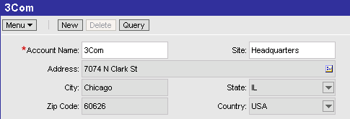
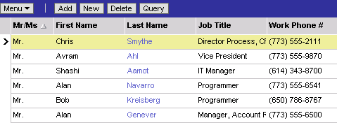
Web Templates
Contain placeholders for Siebel logical UI definitions
Notes:
Web templates contain placeholders. For example, view Web templates contain placeholders for applets. Applet Web templates contain placeholders for controls and list columns.
The example in the slide shows a form applet being bound to a placeholder at the top of the Web template, and a list applet being bound to a placeholder at the bottom of the Web template. This is the standard layout for a detail view.
Notice that unmapped placeholders are ignored at runtime.

Slide 6
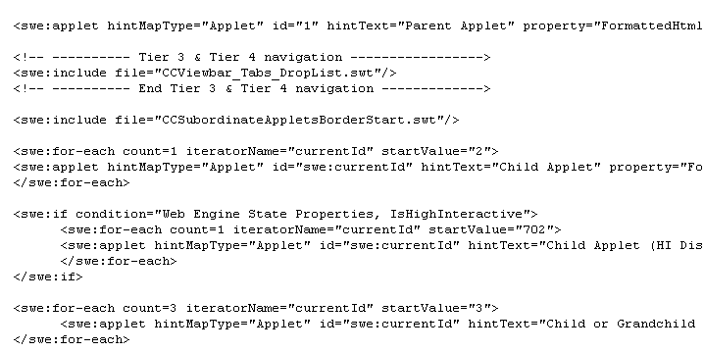
Web Template Files
Are HTML files that end with the extension .swt
  Contain HTML tags
  Contain Siebel specific tags (begin with swe:)
Notes:
Web template files use swe: tags such as swe:applet (which displays an applet) and swe:include (which references the code from another Web template file).
The Web template file in the example is from the Web template View Detail (Parent w/ Pointer). The code creates a placeholder for a parent applet at the top, and a child applet below it.
It then creates a placeholder for a child applet that will be displayed in high interactivity clients only. The swe:if statement checks to see if the client is high interactivity, and, if it is, the applet is displayed. Otherwise it is not.
Last but not least, the code creates three placeholders for child or grandchild applets that should be displayed at the bottom of the view.

Slide 7
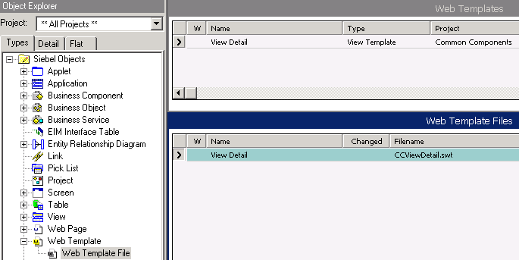
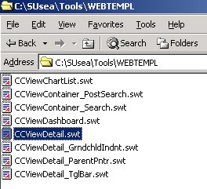
Web Template Object Definition
References a Web Template File
Notes:
The Web Template object definition is a layer of abstraction between a UI object definition (View, Applet or Web Page) and the file itself. UI object definitions reference the Web template object definition, which references the file name.
If a customer chooses to modify or create a Web template file, they can change the reference to the filename in a single place, the Web Template object definition, and the change will be propagated to all the UI object definitions that reference it.
Customers should not create or modify Web template files in employee applications unless there is a significant ROI benefit. Customers may choose to modify Web template files in customer applications to incorporate the look and feel of their existing corporate Web site.

Slide 8
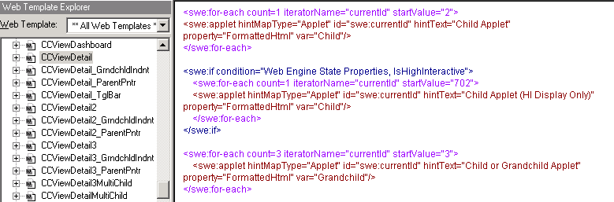
Web Template Explorer
Is used to examine templates in Siebel Tools
  Navigate to View > Windows > Web Templates Window
Displays templates from C:/SUsea/tools/WEBTEMPL
  To modify templates, use the HTML editor of your choice
Highlights Siebel supplied tags for easy viewing
Note: See the Siebel Tools Reference for more SWE tags
Notes:
The Siebel Tools Web Templates Window displays files from the Tools/WEBTEMPL directory. However, these are not the same files that the client and server use.
The Web Client uses template files in the Siebel Server directory. Web Client Web template files are located in the <Siebel Server root>/WEBTEMPL directory, for example, C:/sea77/siebsrvr/WEBTEMPL
The Dedicated Web Client uses template files in its installation directory on the local machine. Dedicated Web Client Web template files are located in the <client root>/WEBTEMPL directory, for example, C:/sea77/client/WEBTEMPL

Slide 9
Types of Web Templates
0/4
Form Applet Web Templates
List Applet Web Templates
View Web Templates
Web Page Web Templates
Notes:
This is a structuring slide. Do not teach the steps or concepts here because the following slides cover them in detail.

Slide 10
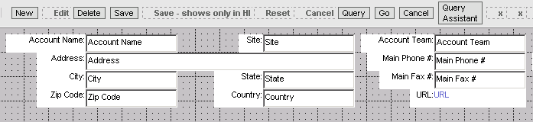
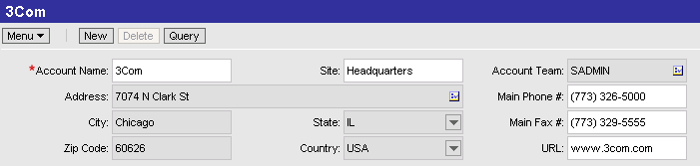
Form Applet Web Templates
1/4
Define the layout of form applets
  Button controls
  Textbox controls
The Account Entry applet uses the Applet Form Grid Layout template
The Object Manager uses the template to build this familiar applet
Notes:
Form applet Web templates are used to display controls such as buttons, labels and textboxes.
Siebel 7.7 uses a form applet Web template called Applet Form Grid Layout. This template does not contain explicit placeholders, but is laid out in a grid. Each point on the grid may be addressed by an applet Web template item, which gives greater flexibility to the layout of controls.

Slide 11
List Applet Web Templates
2/4
Define the layout of a list applet
Support different modes
  Standard Interactivity list applets use Base and Edit modes
  High Interactivity list applets use EditList mode
Notes:
List applet Web templates contain explicit placeholders for the button controls and list columns displayed in the applet.
This slide names the three modes in which list applets may be displayed in standard and high interactivity. The next two slides discuss these modes in more detail.

Slide 12
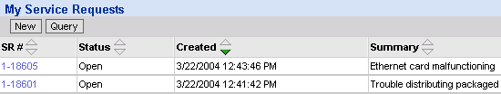
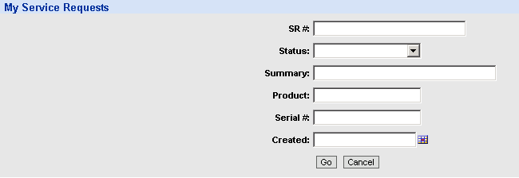
List Applet Web Templates Continued
2/4
Standard interactivity clients require two modes
  Base
  Edit
Base mode appears as a read-only
list of data with buttons for editing
Edit mode appears as an
editable form for querying
and data entry
Notes:
Standard interactivity clients use base mode to display a list of data in an applet. List applets in base mode are read only. If a user tries to create, edit, or query data in a base mode list applet, the applet will be displayed in edit mode.
Edit mode typically appears as an editable form. This context is familiar to Web users. When users fill out data in the editable form and click OK (or Save), the list applet reappears in base mode with the updated record or query results displayed.

Slide 13
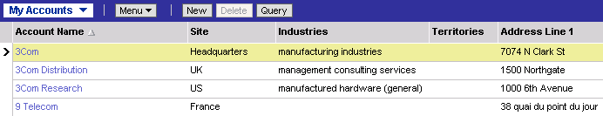
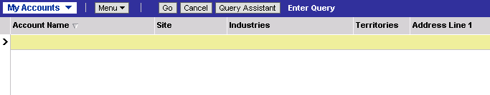
List Applet Web Templates Continued
2/4
High interactivity clients require one mode
  EditList – Use Applet List (Base/EditList)
EditList mode appears as
an editable list of data
EditList mode supports
querying and data entry
directly in the list
Notes:
High interactivity clients use a single mode, EditList, to display a list of data in an applet. List applets in EditList mode display data in an editable list. If a user tries to create, edit, or query data in an EditList mode list applet, they will be able to do so in the current applet context.

Slide 14
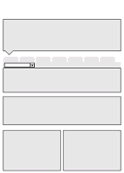
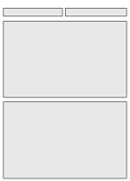
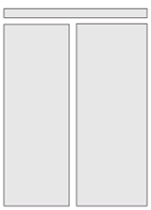
View Web Templates
3/4
Define the layout of a view
  Common view templates include:
View Detail (Parent with Pointer)
View Basic
View 50 50
Notes:
View Web templates contain placeholders for applets. The Siebel application uses many different view Web templates. These are some common examples.

Slide 15
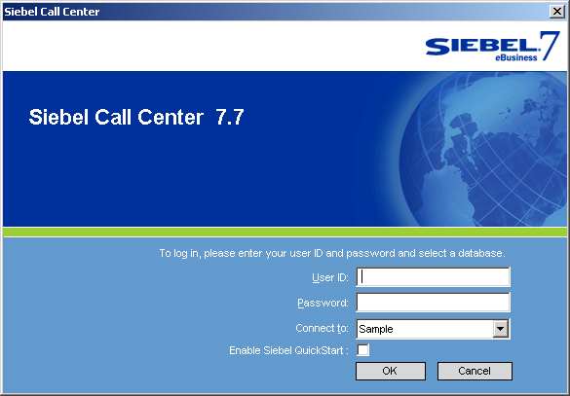
Web Page Web Templates
4/4
Define the layout of Web pages such as:
  Login Page
  Error Page
  Container Page
The Login Web template
defines the layout of the
Login Page
Notes:
Web page Web templates are used by the Web Page object type. Web Pages are not discussed in detail in this class. Some examples are given on this slide.

Slide 16
Summary
This module showed you how to:
  Describe the Physical User Interface
  Describe the role of Siebel Web Template files
  List the types of templates
  List the object definitions that relate UI objects to the template files

Slide 17
Lab
In the lab you will:
  To practice using the Web Template Explorer and to examine the relationship between views and applets, and their associated templates.
Notes:
See lab instructions for details.

